Slide 1
IDMA website
Wireframe

Slide 2
______________HEADER____________________________
Home Button (Logo)
About Us
Membership
Corporate
Educational Organizations
Freelancers
Agencies
Events
Summit
Bootcamp
Webinar
Training & Education
Agency Certification
Awards
Partnership Opportunities
Contact us
____________________FOOTER___________________________
FAQ
Privacy Policy
Blog & Articles
News
Interviews
Press & Media
Jobs
Job Seekers
Employers
Tools & Resources (Free Download)
White Paper
Articles
Chapters
Social Media (icons)
Login

Slide 3
Home Page

Slide 4
About Us

Slide 5
Training & Education

Slide 6
Certification

Slide 7
Events

Slide 8
Awards

Slide 9

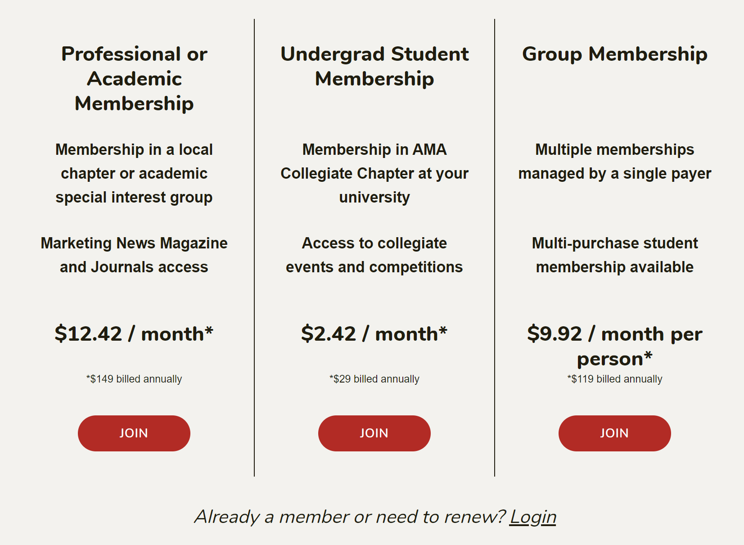
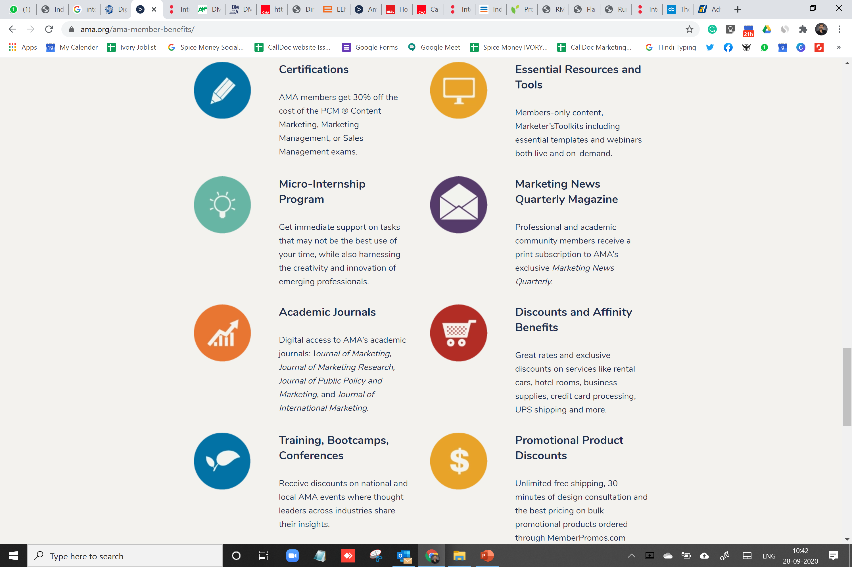
Membership
https://www.ama.org/ama-member-benefits/

Slide 10
FAQ

Slide 11
Privacy Policy

Slide 12
Blog

Slide 13
Press & Media

Slide 14
Jobs

Slide 15
Tools & Resources

Slide 16
Contact Us

